Slide 1

First-and-Last Touch Attribution Project
Learn SQL from Scratch
Dustin Rupe
12/19/2018

Slide 2
Table of Contents
Getting familiar with CoolTShirts
What is the user journey?
Optimize the campaign budget

Slide 3
Getting Familiar with CoolTShirts

Slide 4
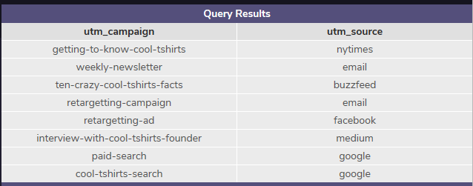
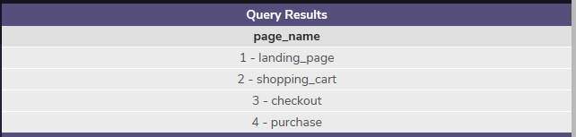
The CoolTShirts Company
How many campaigns and sources does CoolTShirts use and how are they related?
There are 8 campaigns and 6 sources used with CoolTShirts
A campaign identifies a specific ad or email blast, whereas a source identifies which site sent the traffic.
CoolTShirts has 4 pages: a landing page, a shopping cart page, a checkout page, and a purchase page.
The following SQL code was used to find the results:
SELECT count(DISTINCT utm_campaign)
FROM page_visits;
SELECT count(DISTINCT utm_source)
FROM page_visits;
SELECT DISTINCT utm_campaign
,utm_source
FROM page_visits;

Slide 5
What is the user journey?

Slide 6
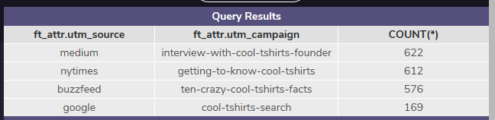
What is the user journey?
How many first touches is each campaign responsible for?
There are 622 first touches in the interview-with-cool-tshirts-founder campaign.
There are 612 first touches in the getting-to-know-cool-tshirts campaign.
There are 576 first touches in the ten-crazy-cool-tshirts-facts campaign.
There are 169 first touches in the cool-tshirts-search campaign
The following SQL code was used to find the results:
WITH first_touch AS (
SELECT user_id,
MIN(timestamp) as first_touch_at
FROM page_visits
GROUP BY user_id),
ft_attr AS (
SELECT ft.user_id,
ft.first_touch_at,
pv.utm_source,
pv.utm_campaign
FROM first_touch ft
JOIN page_visits pv
ON ft.user_id = pv.user_id
AND ft.first_touch_at = pv.timestamp
)
SELECT ft_attr.utm_source,
ft_attr.utm_campaign,
COUNT(*)
FROM ft_attr
GROUP BY 1, 2
ORDER BY 3 DESC;

Slide 7
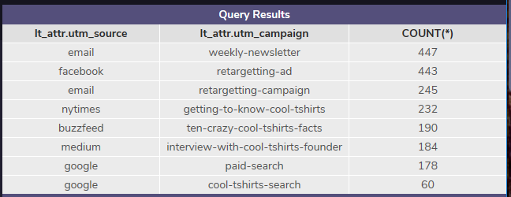
What is the user journey?
How many last touches is each campaign responsible for?
The weekly-newsletter campaign has the highest last touch with 447.
The lowest last touch campaign was the cool-tshirts-search with 60.
Below shows the full results to the last touches for each campaign.
The following SQL code was used to find the results:
WITH last_touch AS (
SELECT user_id,
MAX(timestamp) as last_touch_at
FROM page_visits
GROUP BY user_id),
lt_attr AS (
SELECT lt.user_id,
lt.last_touch_at,
pv.utm_source,
pv.utm_campaign
FROM last_touch lt
JOIN page_visits pv
ON lt.user_id = pv.user_id
AND lt.last_touch_at = pv.timestamp
)
SELECT lt_attr.utm_source,
lt_attr.utm_campaign,
COUNT(*)
FROM lt_attr
GROUP BY 1, 2
ORDER BY 3 DESC;

Slide 8

What is the user journey?
How many visitors make a purchase?
There were a total of 361 visitors to CoolTShirts that made a purchase.
The following SQL code was used to find the results:
SELECT COUNT(DISTINCT(user_id)) AS user_id,
page_name
FROM page_visits
WHERE page_name = '4 - purchase';

Slide 9
What is the user journey?
What is the typical user journey?
It appears that the customer first come to the CoolTShirts webpage the most through a medium, the nytimes, or a buzzfeed. However, it doesn’t appear that purchases are made at this time.
Users are most drawn back to the website for a purchase due to an email or a social media platform like facebook.
Google is not used as often in getting the user to the website nor is it often used to get the user back to the website.
First Touch
Last Touch

Slide 10
Optimizing the campaign budget
Which campaigns should be invested in?
After looking at the results of the data, it appears that the top 5 campaigns that should be invested in are as follows:
Medium
NY Times
Buzzfeed
Email
Facebook
Users are initially drawn to the website by either going their directly, or clicking on an ad or a buzzfeed. The user then returns to the website to make a purchase because of an email they received from CoolTShirts, or by seeing CoolTShirts on their social media account.
These are high quality campaigns that are well worth the investment because ads can show up on any website they go to and users always use email and social media on a daily bases. These campaigns will get the best bang for the buck.
First Touch
Last Touch

Slide 11
Thank you!

